Slide 1
Overview of Spring Data JPA

Slide 2
Agenda
Introduction to Spring Data
Main Modules in Spring Data
What is JPA ?
Introduction to Spring Data JPA
Features of Spring Data JPA
Demo: Quick Start
End bits (links and such)

Slide 3
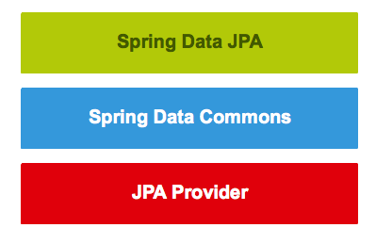
The Structure Of Our Repository Layer

Slide 4
Introduction To Spring Data
Spring Data’s mission is to provide a familiar and consistent, Spring-based programming model for data access while still retaining the special traits of the underlying data store.
It makes it easy to use data access technologies, relational and non-relational databases, map-reduce frameworks, and cloud-based data services. This is an umbrella project which contains many subprojects that are specific to a given database.

Slide 5
Main Modules Of Spring Data
Spring Data Commons
Spring Data JDBC
Spring Data JDBC Ext
Spring Data JPA
Spring Data KeyValue
Spring Data LDAP
Spring Data MongoDB
Spring Data Redis
Spring Data REST
Spring Data for Apache Cassandra
Spring Data for Apache Geode
Spring Data for Pivotal GemFire

Slide 6
What Is JPA?
JPA is a Java standard that allows us to bind Java objects to records in a relational database.
It's one possible approach to Object Relationship Mapping(ORM), allowing the developer to retrieve, store, update, and delete data in a relational database using Java objects.
Several implementations are available for the JPA specification like
Hibernate
TopLink
ORMLite
iBATIS
JPOX

Slide 7
Introduction To Spring Data JPA
The Spring Data JPA is one of the many Spring Data projects and it aims towards bringing consistency in accessing data for relational datastores.
Spring Data JPA provides a framework which works together with JPA and provides a complete abstraction over the Data Access Layer in a project. Spring Data JPA brings in a concept of JPA Repositories a set of Interfaces which defines query methods.
Many people consider Spring Data JPA as a JPA implementation. In reality it is false. Spring Data JPA uses a default JPA Implementation called as Hibernate. The default JPA implementation is configurable and if we wish we can use other implementations as well.
Let take at the name of ‘Spring Data JPA’.
‘Spring’ means it is a part of the Spring Data family.
“Data” is means support working with data.
And ‘JPA’ means that it follows the Java Persistence API.

Slide 8
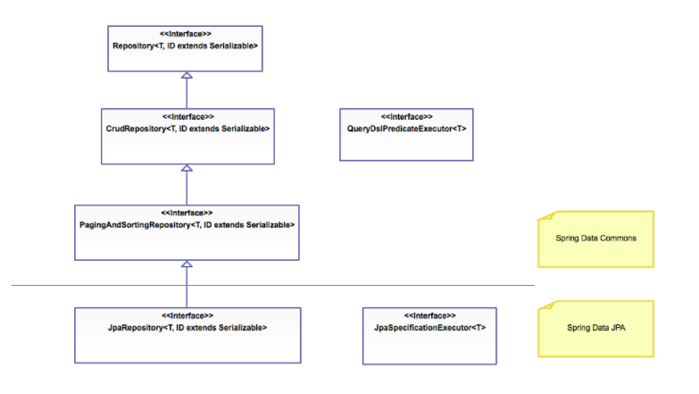
Repository Hierarchy

Slide 9
Few Features
Create and support repositories created with Spring and JPA
Support QueryDSL and JPA queries
Audit of domain classes
Support for batch loading, sorting, dynamical queries
Supports XML mapping for entities
Reduce code size for generic CRUD operations by using CrudRepository

Slide 10
Few Annotations In Spring Data JPA
Entity
Id
Table
Column
Transient
GeneratedValue
OneToOne

Slide 11
Types Of Mapping
One-to-one - This association is represented by @OneToOne annotation. Here, instance of each entity is related to a single instance of another entity.
One-to-many - This association is represented by @OneToMany annotation. In this relationship, an instance of one entity can be related to more than one instance of another entity.
Many-to-one - This mapping is defined by @ManyToOne annotation. In this relationship, multiple instances of an entity can be related to single instance of another entity.
Many-to-many - This association is represented by @ManyToMany annotation. Here, multiple instances of an entity can be related to multiple instances of another entity. In this mapping, any side can be the owing side.

Slide 12
Links
https://app.pluralsight.com/paths/skills/spring-framework-data-access-with-spring
https://www.pluralsight.com/courses/spring-data-jpa-getting-started
https://start.spring.io/
https://spring.io/projects/spring-data
https://spring.io/projects/spring-data-jpa
https://devservices.ford.com/dev-guides
https://github.ford.com/DevEnablement/pcfdev-guides/blob/master/persistence/README.md

Slide 13
Thank You.. !!

